Slide 1


HVS​
Concept of Chassis Torque Management

Slide 2

Contents
Pedal Analysis
Accelerator Pedal Drive Control
One Pedal Control
Creep Control
Brake Torque
ADAS Control
Coast Control
Driver Torque Coordinates
Vehicle Stability Intervention

Slide 3
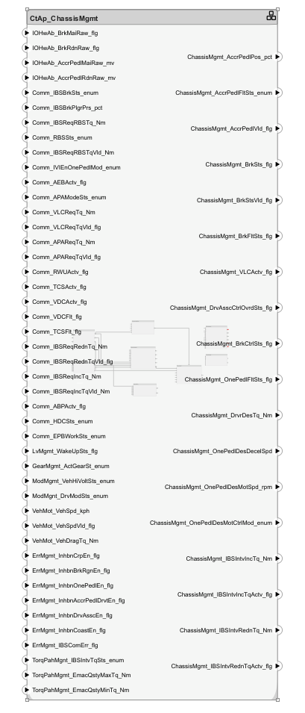

Function Behavior

Slide 4
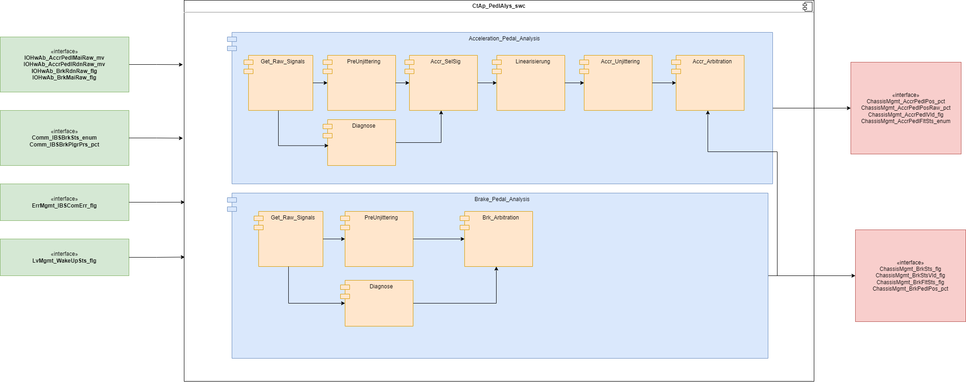
Pedal Analysis
The pedal analysis module analysis accelerator pedal sensor and brake pedal sensor to identify the user's driving intention
This function mainly uses the voltage of the accelerator pedal position sensor, calculated by a formula, and converted into the opening of the accelerator pedal to identify the user's driving intention.
The braking intention is judged by reading the switch state of the pedal switch sensor and the braking state signal sent by the IBS

Slide 5
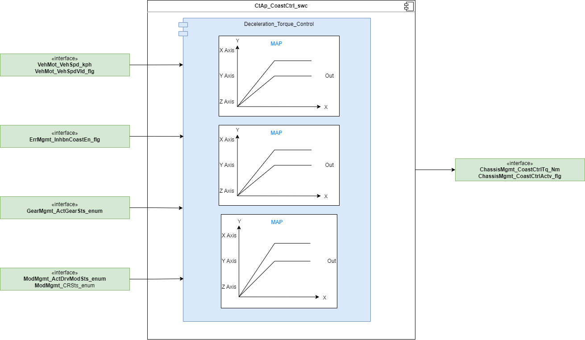
Coast Control
The function calculates the desired coast torque based on the accelerator pedal position and vehicle speed.

Slide 6
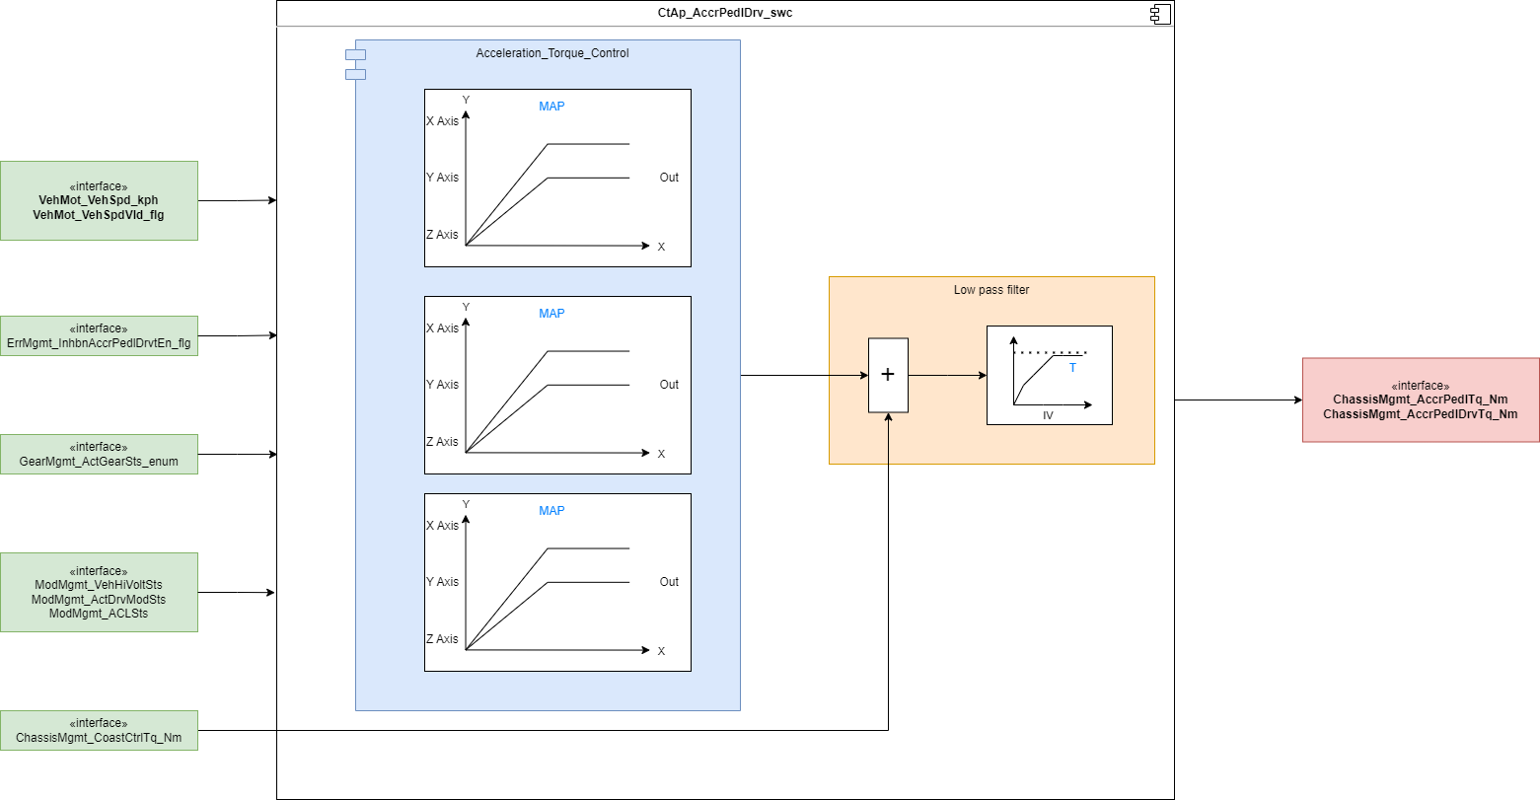
Acceleration Pedal Drive Torque
The function calculates the Driver desired torque based on the accelerator pedal position and vehicle speed.

Slide 7
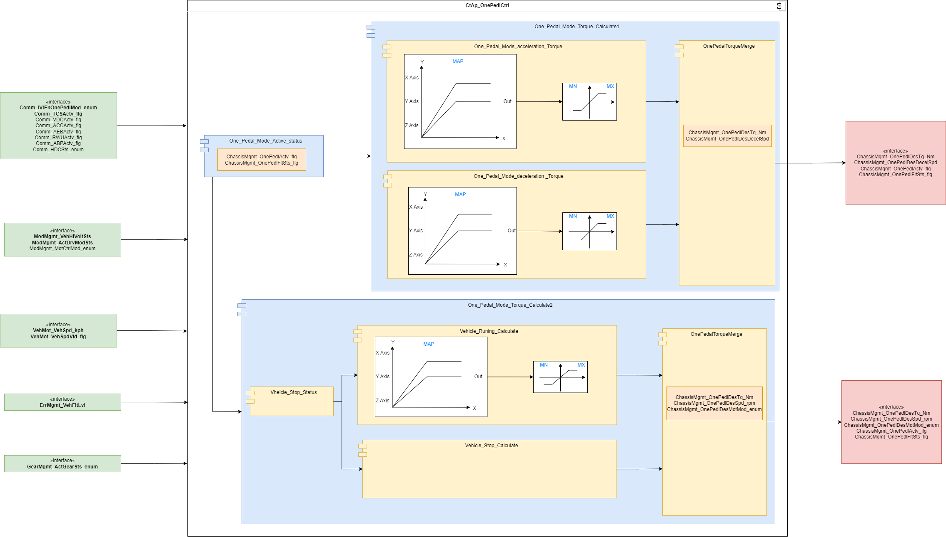
One Pedal Ctrl
The One pedal function is a driving mode in which the driver only relies on the accelerator pedal to accelerate and brake to a certain extent. In the single pedal driving mode, the driver can release the accelerator pedal to a certain extent to achieve torque recovery braking

Slide 8
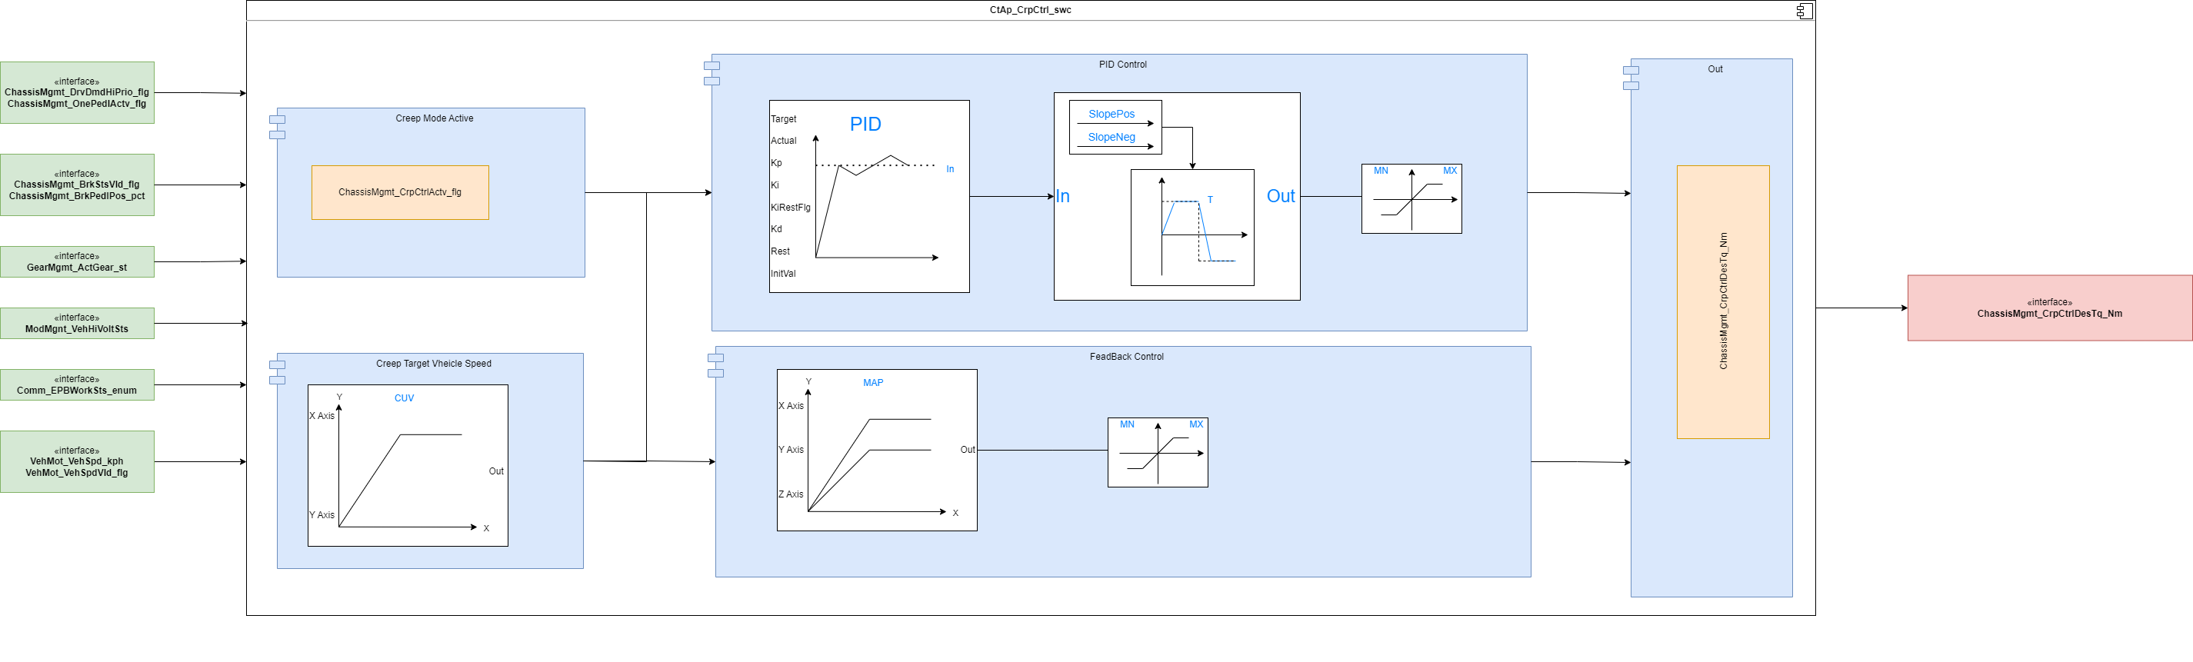
Creep Control
The crawling controller has the task of accelerating the vehicle to a minimum speed. This way, a torque is specified with the help of the controller, which is furthermore coordinated in the torque path in a maximum selection
Generally the crawling controller is formed with the help of one single controller structure (PI-controller with feed forward control)

Slide 9
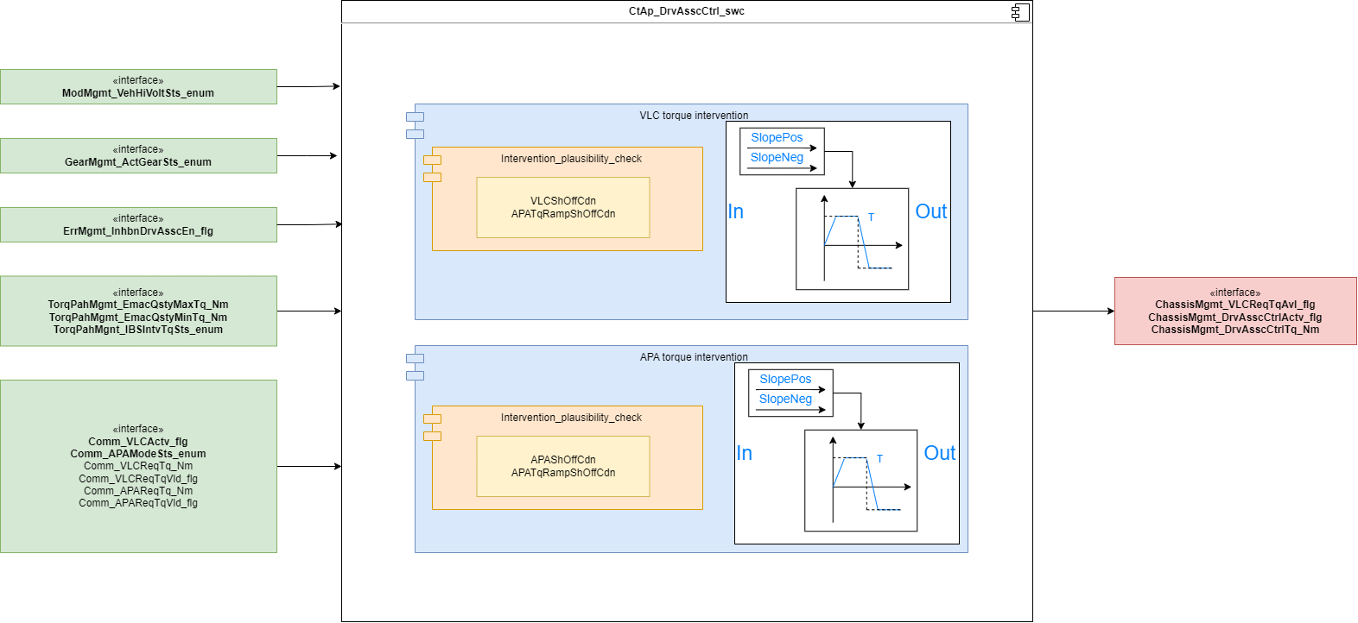
Driving Assistance Control
The driving assistance computes the torque requests of the functions (ACC, VLC and APA)

Slide 10
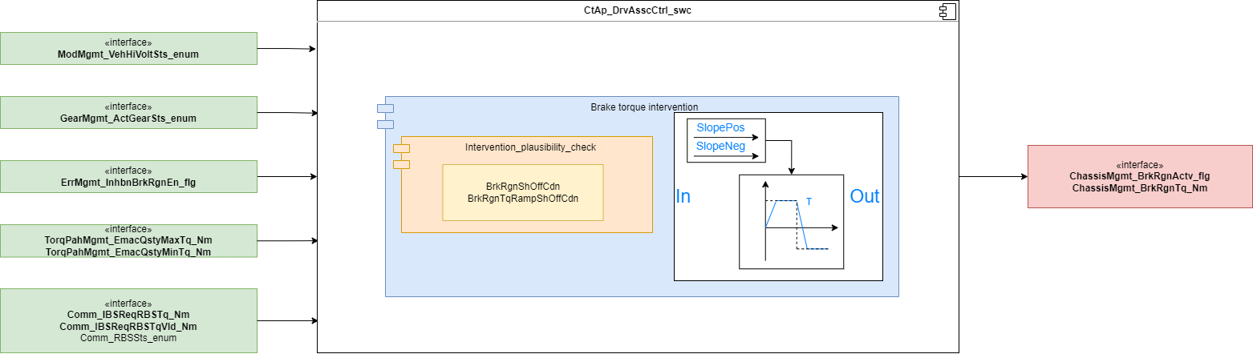
Brake Management
The brake regeneration computes the torque requests of the functions (RBS)

Slide 11
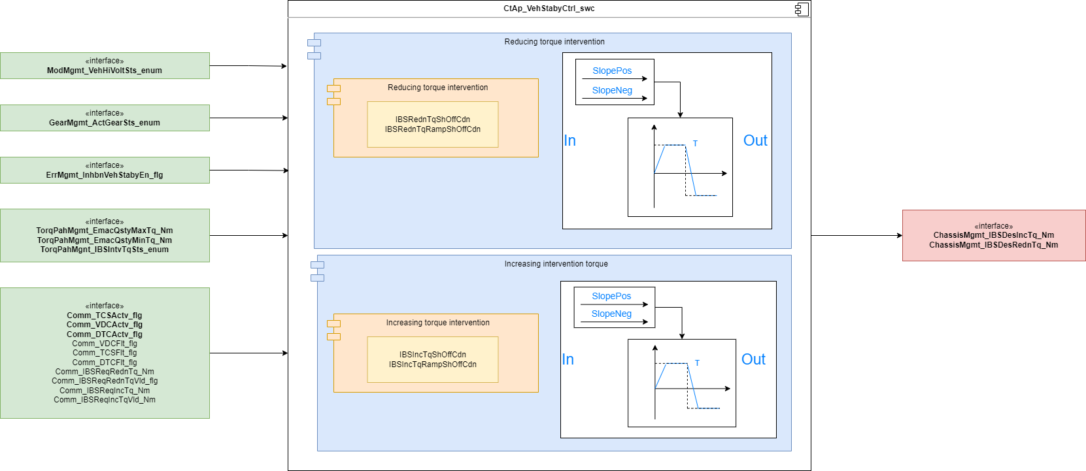
Vehicle Stability Control
Increasing intervention torque (DTC) The increasing torque intervention (wheel torque) is received and transmitted to the torque coordination directly in case of permitted intervention. The intervention status are read for determination of permissibility of increasing intervention.
Reducing torque intervention (TCS/VDC) The decreasing torque interventions (wheel torque) is received and transmitted to the torque coordination directly in case of permitted intervention. The intervention status are read for determination of permissibility of reducing intervention

Slide 12
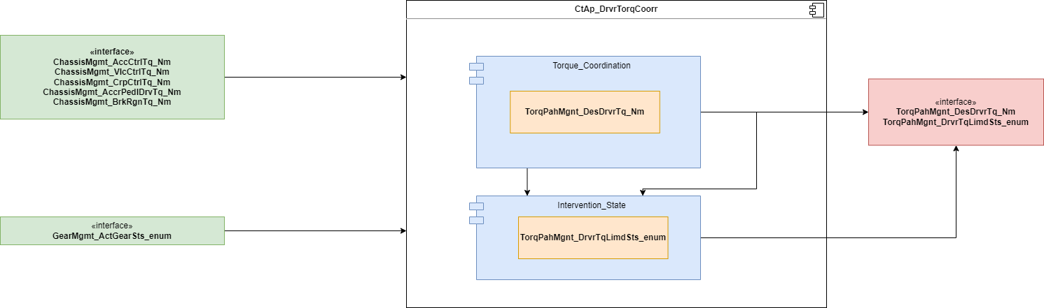
Driver Torque Coordinator
The function “CtAp_DrvTorqCoorr" coordinates all propulsion torque requests and provides the result to the torque path
The main task of the function CtAp_DrvrTorqCoorr is to coordinate driver wish from the accelerator pedal and the propulsion torque request from the Creep controller. The torque request from cruise control, longitudinal limiter(CrpCtl,ADAS,BrkCtrl,OnePedalCtrl and SpdLim) are coordinated depending on the configuration.

Slide 13
Backup

